Slide 1
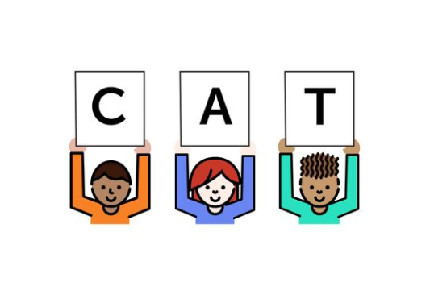
Foundational Skills Mini-Course
Module 4: Phonics (Part 2) – Application
Notes:
This module was last updated on April 2018.
Welcome to the second phonics module.

Slide 2


Course Instructors
David Liben,
Senior Content Specialist
Carey Swanson, ELA/Literacy Specialist

Slide 3
About Student Achievement Partners
Student Achievement Partners is a nonprofit organization dedicated to helping teachers and school leaders implement high-quality, college- and career-ready standards. We believe that challenging academic standards are the foundation for improved student outcomes, but that standards alone are not enough. Students will only make dramatic gains in achievement if instructional materials, assessments, and classroom practices are true to the expectations of high-quality, college- and career-ready standards.
Our work is grounded in research and evidence, and we are committed to sharing standards-aligned tools and practices freely with educators across the country. Our website, achievethecore.org, offers hundreds of math and literacy instructional resources for teachers and school leaders.

Slide 4
Goals for This Module
Identify concrete instructional moves to support phonics instruction in the classroom.
Connect phonics instruction to students’ writing and spelling.
Notes:
Let’s review the goals for this module.

Slide 5
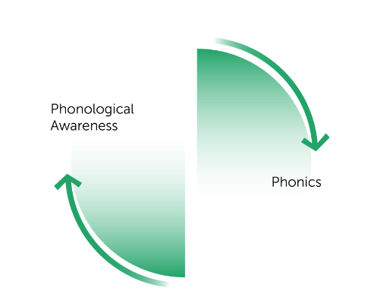
From LISTENING to LETTERS
Let’s review how phonemic awareness sets up students for early reading and writing.
Phonemic
Awareness
Phonics
Notes:
Big Idea:
This work that takes place between PA and Phonics is important because it sets up students for future learning.
Details:
We’ll look more closely at how the two work together as students are learning to be early readers and writers.

Slide 6

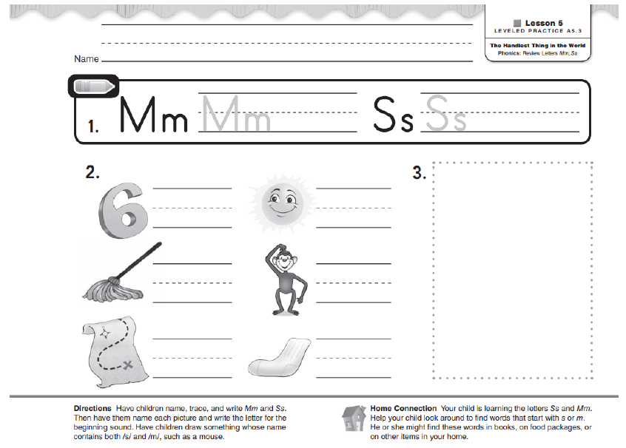

From Phonemes to Graphemes
When I see M/m I say “mmmm”
Notes:
As we discussed in Module 3, when we begin phonics instruction, we move from phonemes and sounds to the graphemes that represent these sounds.
Students must be given the opportunity to hear and say these sounds, as well as read and write.
Note the instruction will progress at the rate of student learning so, as they learn more sounds, they’ll be able to read and write more words. Here, they’re just learning initial consonants, so that is the content of their writing.

Slide 7

The HOW of Phonics
Notes:
Now we’ll move into some more practical guidance for how to teach systematic phonics effectively.

Slide 8


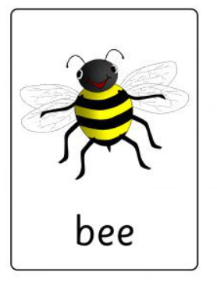

HOW Do We Teach These Sound and Spelling Patterns?
Hear it
Say it
Read it
Spell it
/ee/
/ee/
Notes:
In teaching sound and spelling patterns, it is important that we are giving students multiple “at bats” with all the related skills. They need to be able to hear the sound, say the sound, read words that contain the sound, and spell the sound using the graphemes that represent it.
Let’s take a closer look at what each one means.

Slide 9
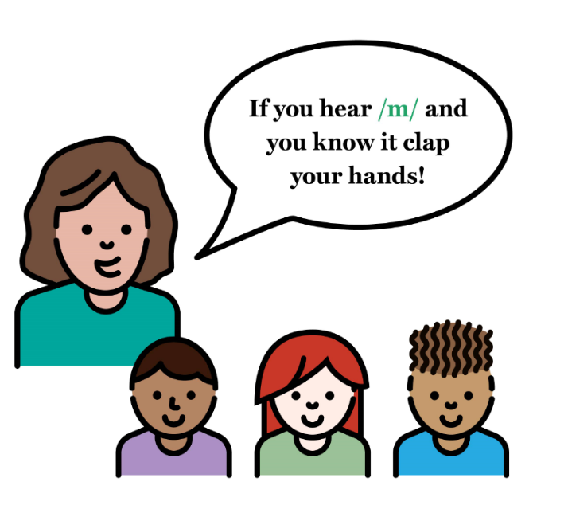
Hear it
/ee/
/ee/
Notes:
In this case, students are listening for the long e sound. This task is based on oral discrimination. Students can not be expected to read or write a sound they aren’t able to hear.

Slide 10


Hear it
feet
Say it
/ee/
/s/ /l/ /ee/ /p/
Blend these sounds:
/f/ /ee/ /t/
Segment these words:
sleep
Notes:
Next comes saying the sound.
Note that there are many ways to do this. Blending, or combining individual phonemes into words, and segmenting, or breaking up words into their individual phonemes, are both important instructional routines.
Note effective engagement strategies as well as kinesthetic tips here. Students can tap out the sounds on their fingers, or across their arms, or stand up and do full body movements, or throw a ball for each sound– there are so many ways to make this work fun!

Slide 11
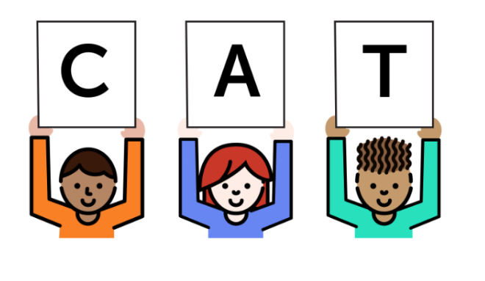
Hear it
/ee/
Say it
/ee/
t
r
ee
Read it
Let’s use what we know to read some words with the /ee/ sound together!
Notes:
Next, students read words that contain the new sound and spelling pattern. This helps them to connect the new skill they are learning to decoding words.

Slide 12

Hear it
/ee/
ee
Say it
/ee/
beet cheek
knee seen
sleep meet
flee free
The tree is green.
Read it
This is a picture of the /ee/ sound. Let’s read some words together!
Notes:
They can do this with word lists. Note the variation, with the graphemes found in the middle as well as the end of words in this example.

Slide 13



Hear it
/ee/
Say it
Read it
Dan sees a bee.
Let’s read a new story. Look out for words with our new ‘ee’ spelling!
Notes:
And they can read in real texts.
We’ll talk more about decodable readers in the next module, but this allows students to connect new sound and spelling patterns with those they already know, as well as high-frequency words.
Students will not connect this work to the act of reading unless they spend time doing it!

Slide 14
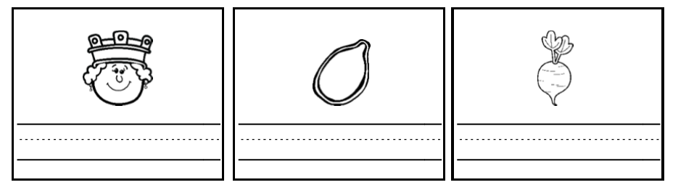
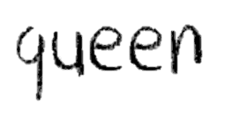
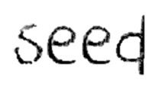
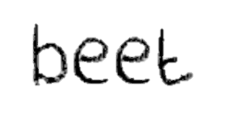

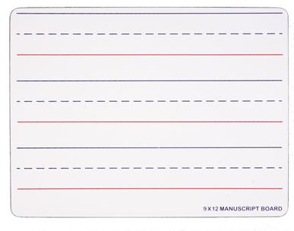




Hear it
/ee/
Say it
/ee/
Read it
Spell it
Notes:
Finally, it is important that students get a chance to spell words with the new sound and spelling pattern, and that they do this in writing.
Note that students should be writing the full word, and drawing their attention to the new sounds, to connect these in their brains.

Slide 15
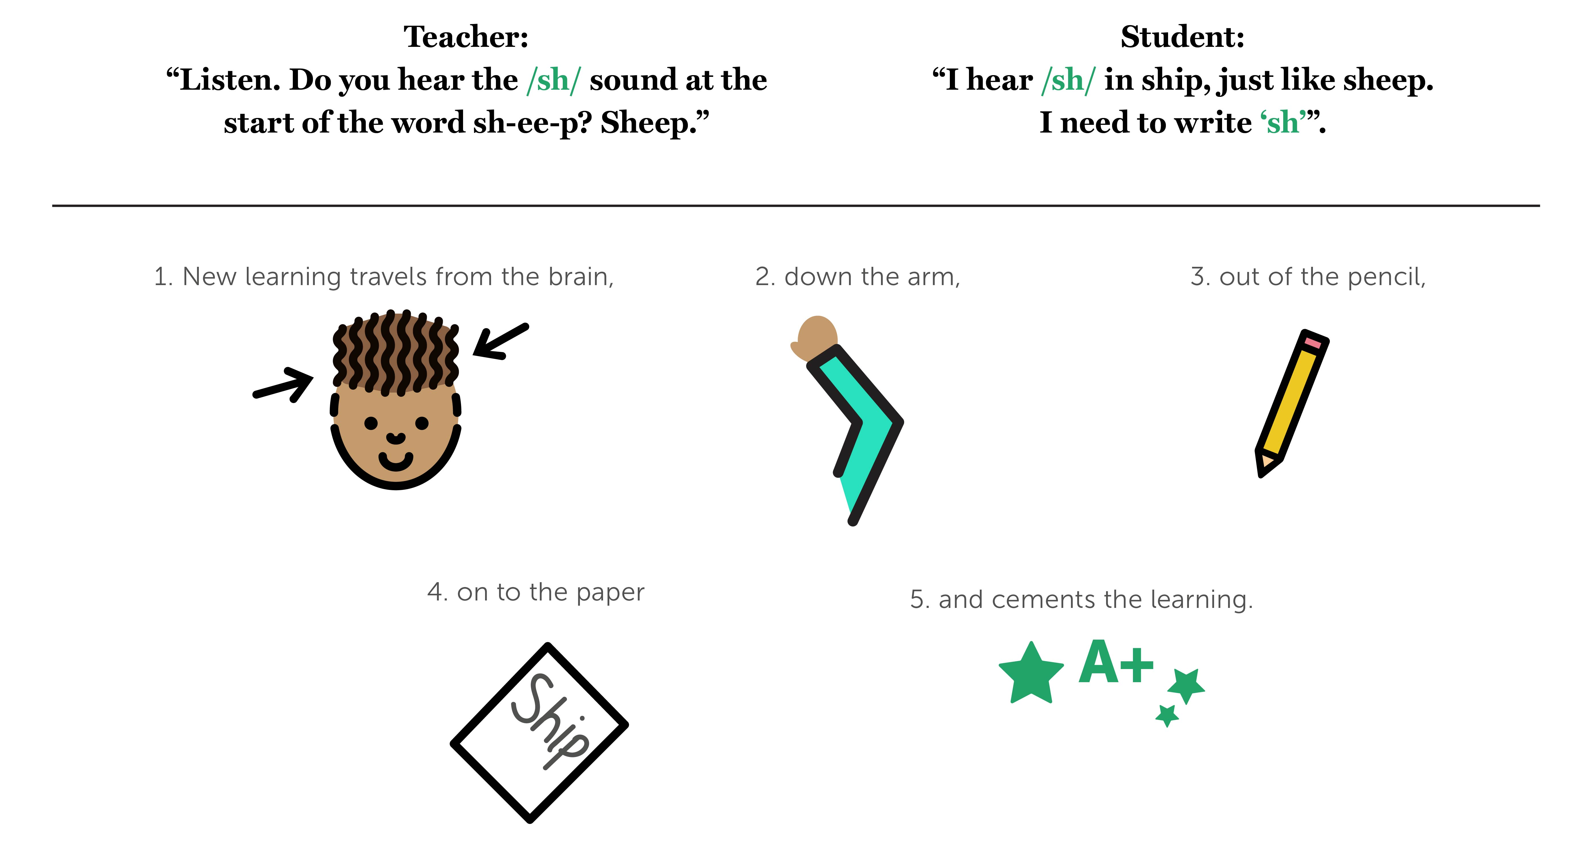
Students need to HEAR, SAY, READ, and SPELL the sounds they learn.
Notes:
****
As we discussed in the online discussion last week, phonemic awareness facilitates this learning. Students need to listen to the sounds in instruction, say them themselves, and this new learning, in essence, travels from the brain, down the arm, through the pencil, and on to the paper to cement the learning.

Slide 16
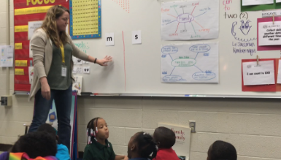
Phonics in One of Our Pilot Classrooms!
Ms. Calame – Kindergarten, Alex Green Elementary
Access the video at: https://vimeo.com/253462895
Notes:
Let’s take a look at this in action, with the content we looked at earlier: ‘m’ and ‘s’ in early K.
https://vimeo.com/253462895

Slide 17
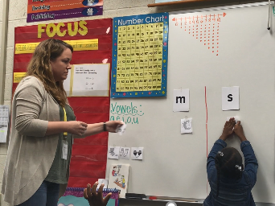
Phonics in One of Our Pilot Classrooms!
Highlights:
Using pictures to connect initial sound to ‘m’ and ‘s’
Connecting to meaning “…a sandwich for lunch”
Corrective feedback
Focused materials
Notes:
Note the highlights of this lesson.

Slide 18
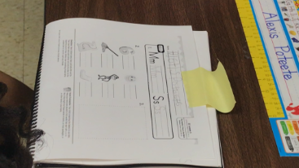
Continued: Phonics Student Practice!
Ms. Calame – Kindergarten, Alex Green Elementary
Access the video at: https://vimeo.com/253463272
Notes:
We will now take a quick look at student practice. Remember, we are looking for an interplay between teacher modeling and students tasks– orally, and in reading and writing.
Access the video at: https://vimeo.com/253463272

Slide 19
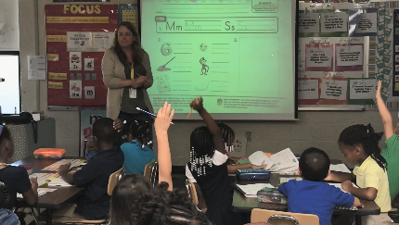
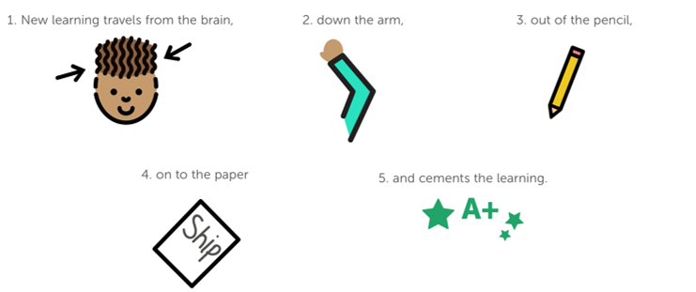
Phonics in One of Our Pilot Classrooms!
Highlights:
Directly connected to content of phonics lesson
Embedding of print concepts (handwriting)
Teacher monitoring
Next step: Let students practice with independence!
Notes:
Here are some of the highlights from what we saw, as well as the next step for this teacher to move students further.

Slide 20
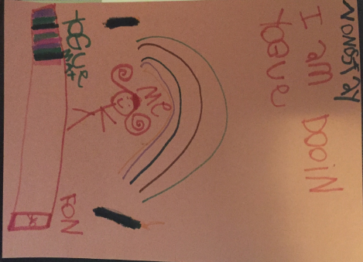
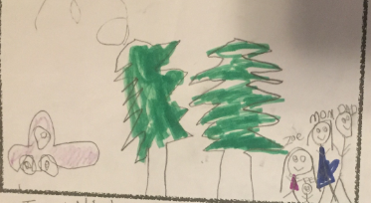

Inventive Spelling: a regular assessment of phonemic awareness and the alphabetic principle!
Combine with visual information to get a sense of comprehension and meaning!
Notes:
We can get a sense of how students are mastering sound and spelling patterns by seeing it in their writing.
Here are some fun examples ☺
Take a look at this sample of K writing. Grade-appropriate skills such as early high-frequency words are strong, and there is a sense of words and spacing. The child is spelling creatively (“wat” for “went) with words that go beyond taught sound and spelling patterns.
When trying to get a sense of students’ comprehension, it is helpful to include drawing opportunities. You may not have understood this final word– see if the picture helps you! (“Christmas-tree-store”!)
One more sample- I’ll explain this one to you! It says “Namaste, I am doing yoga”. There is a picture of thee yoga mat, the speaker, a rainbow…and a phone!

Slide 21

Connecting Sounds to Spelling
Notes:
We will move into a few more tasks connecting sounds to spelling.

Slide 22

Task: Connecting Sounds to Spelling
How might a student write these words?
went
rain
truck
Write out as many as you can and discuss with your colleagues!
Notes:
We are going to take a closer look at the connection between writing and knowledge of sounds in words.
Let’s start with a quick task to get you thinking. On the screen you’ll see three words. On your paper, write them in several ways, the way a K or 1st grade student might write them.
Words: went, rain, truck
Discuss or consider: what errors did you think of that children might make, and why?
Resume: common errors include: only initial and end sounds, missing some sounds in words – as in the n in went, incorrect vowels- rane for rain, incorrect consonant blends (no r in truck, or /ch/ for /tr/)

Slide 23
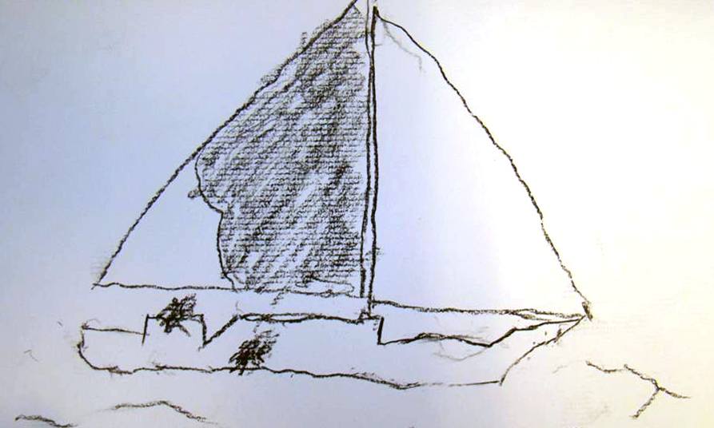
Inventive Spelling
First sound | b
First sound + last sound | bt
First, last and some or all medial sounds | bot
Phonetic spelling (but not including orthographic requirements) | bote
Correct spelling | boat
Notes:
Many of you were likely reflecting on your observations and experiences with inventive spelling. Students tend to move from squiggles or lines on paper to some sort of use of letters, often starting with initial sounds, then moving to first and last sounds, and over time filling in medial sounds with some form of phonetic spelling, before arriving at correct spelling.
This progression is good, if it matches instruction! Students should be listening for sounds they know and spelling them using the letter or sound spelling correspondences they have learned.

Slide 24

Reinforcing accurate spelling is important!
Drawing students’ attention to how sounds are represented by letters helps reinforce new learning.
Keep your scope and sequence in mind – if the sound and spelling pattern has been taught, it should be written accurately.
Notes:
*****
Ultimately, we want to build towards accuracy. This means being cautious about your own modeling and corrective feedback. Reinforce accurate spelling whenever it matches what they have been taught, or when you see attempts at this by students based on their own reading or background knowledge. Draw students’ attention to how sounds are represented in new words– this helps to reinforce the learning! And keep your scope and sequence in mind: if it has been taught, it should be written correctly.

Slide 25

How Do We Teach Phonics to Children?
Early K:
15–20 minutes daily
Mid-late K, 1st, and 2nd:
20–30 minutes daily
Guideline: TIME
Notes:
Again, phonics is a huge priority that demands instructional time.
In early K, phonemic awareness takes a lot of time. Phonics will have less time while this is being developed. Once students reach mid to late K, and through 1st and 2nd grade, 20-30 minutes a day is necessary to build this skillset.

Slide 26

(Remember!)
Guidelines for Instructional Time
Student Practice
Whole Group Instruction
Small Group Instruction
Guideline: TIME
Notes:
Remember the big idea around instructional time! (When suggesting guidelines for instructional time, note that these timeframes can be thought of from the individual student perspective– including the time a child is spending in whole group instruction, doing individual or group meaningful practice, and within small group instruction.)

Slide 27

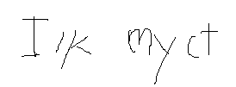

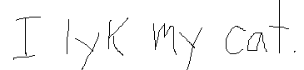
Writing Samples: “I like my cat.”
What do these writing samples tell you about the child’s knowledge of letters and sounds?
Student Attempt | Transcription
A) | i l m ct
B) | I lk my ct
C) | I lik my cat
D) | I lyk my cat.
Notes:
Let’s take a second to think about how students build skill in this area. Look at each writing sample, asking yourself to look for the student’s strengths. For each sample, ask: What does this child understand about words, letters, and sounds?

Slide 28

Online Discussion
What do the writing samples tell you about the students? How can student writing serve as an informal assessment? Consider:
Concepts of print
High-Frequency words
Taught sound and spelling patterns
Notes:
We’ll use this for our online discussion this week as you engage in discussing what the writing samples tell you about students, and how student writing can serve as an informal assessment of phonics.

Slide 29
Skilled Readers
Look at letters and see letter patterns.
Recognize more and more letter sequences the more they read!
Over time, perceive words that contain these letter sequences almost instantaneously!
Let’s explore this more closely…
Notes:
******
As we said in Module 1, we are doing this work with the end in mind—we’re looking at what skilled readers do. Skilled readers do the following:
Look at letters and see letter patterns.
Recognize more and more letter sequences the more they read!
Over time, perceive words that contain these letter sequences almost instantaneously!

Slide 30

In Order to…
Look at letters and see letter patterns!
Readers Must:
Identify individual letters.
Identify associated sounds.
Identify letters and sounds in order from left to right.
Do so quickly! (meaning is lost otherwise)
Notes:
Slide content
*****

Slide 31

In order to…
Recognize more and more letter sequences the more they read!
Readers Must:
Attend to print while reading.
Connect words to sound and spelling patterns.
Pay attention to/ notice letter sequences in unknown words.
Read a lot!
Notes:
Slide content
*****

Slide 32

In order to…
Over time, perceive words that contain these letter sequences almost instantaneously!
Readers Must:
Build a bank of taught sound and spelling patterns.
Read whole words containing these sounds.
Read connected text containing taught sounds and spelling patterns and high frequency words.
Connect reading to writing and spelling.
Notes:
Slide content
*****

Slide 33
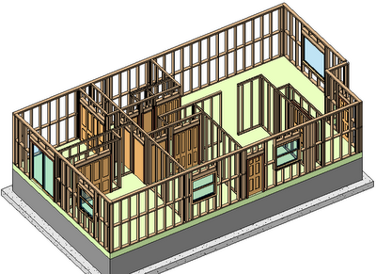

Building the Foundation That Leads to Reading
Notes:
Hopefully you are starting to see how this work builds a foundation that will make each student successful with a book in his or her hands. We’ll explore this connection to reading more closely in the next module.

Slide 34

Module 4: Connect to Practice Task
Option A:
*Collect a set of student writing (at least 6 pieces: 2 high, 2 mid, 2 low).
*Evaluate the inventive spelling – what evidence do you see of taught sound/spelling patterns?
*Compare this to your phonics scope and sequence and/or your school’s approach to phonics: What implications are there for instruction?
Option B:
← Use sample set of student writing to do the task.
Notes:
This week’s task involves looking closely at student writing, and may add some color to the online discussion if you choose to discuss afterwards.
We’re asking you to collect a set of writing samples (if you aren’t school-based, we’ve provided a sample set in the template). Using the template, please do the following:
* Evaluate the inventive spelling- what evidence do you see of taught sound/spelling patterns?
* Compare this to your phonics scope and sequence and/or your school’s approach to phonics: what implications are there for instruction?

Slide 35

Recommended Reading
Blog Post: https://achievethecore.org/aligned/at-the-foundation-of-foundational-skills-structured-phonics/
Why Structured Phonics Paper: https://achievethecore.org/aligned/wp-content/uploads/2017/03/Why-a-Structured-Phonics-Program-is-Effective.pdf

Slide 36



About Achieve the Core
Visit achievethecore.org to find:
Professional Learning Content
PD modules
Research
Aligned Blog
Tools for Planning and Reflection
Instructional Practice Toolkit
Instructional Practice Guide
Lesson Planning Tool
Focus Documents
Alignment rubrics and adaptation guidance
Classroom Resources
Math and ELA lessons
Mini-assessments
Writing resources
Coherence Map
Academic Word Finder

Slide 37

The Core Advocate Network
Who are the Core Advocates?
Core Advocates are educators who:
Believe in the potential of high-quality standards grounded in evidence to prepare all students for college and career.
Understand and embrace the Shifts in instruction and assessment required by college- and career-ready standards.
Are eager to support their colleagues and communities in understanding and translating the Shifts into instructional practice.
What do Core Advocates do?
As instructional advocates, Core Advocates lead other educators in their communities in understanding the Shifts, as well as sharing practices aligned to the Shifts and the standards. Among other actions, Core Advocates:
Lead professional development sessions and professional learning communities.
Create, refine, and share standards-aligned resources with the field.
Advocate for high-quality instruction, instructional resources, and professional learning.
Use and provide feedback on high-quality instructional tools and resources.
How can I get involved?
Join the Core Advocate Network by taking the Core Advocate survey at: www.achievethecore.org/ca-signup
Email coreadvocates@studentsachieve.net with any questions.

Slide 38




Stay Connected
Subscribe for email updates on achievethecore.org
Follow us on social media:
Facebook: facebook.com/achievethecore
Twitter: twitter.com/achievethecore
Pinterest: pinterest.com/achievethecore

Slide 39
Thank You!

